Slide 1
Edge Advanced Mediation
Caching

Slide 2
Why Use Caching
Performance
reducing network latency
eliminate redundant request/response processing
Stability
reduce amount of load to backend services
Scalability
support higher TPS without adding additional hardware
Edge
Server

Slide 3
Caching Policies
Response Cache
caches the entire HTTP response (headers, payload, etc.)
can set a different time-to-live for each entry
option for honoring HTTP cache headers for dynamic TTL (Expires, Cache-Control)
option to support caching of multiple formats based on request ‘Accept’ header
Populate Cache/Lookup Cache
full control over caching, store any objects
add/update and read entries using separate policies

Slide 4
Distributed Caching
Distributed caching allows cache entries to be distributed across multiple Message Processors within a region and across regions.
Datacenter 1
Datacenter 2
Edge Message Processor (L1)
Edge Message Processor (L1)
Edge Cassandra (L2)
Edge Cassandra (L2)

Slide 5
Cache Lookup/Populate Sequence
Edge Message Processor (L1)
Edge Cassandra (L2)
Backend
In Memory = true
In Memory = false
In Cassandra = true
Client
Populate L1
In Memory = false
In Cassandra = false
Populate L2
Populate L1

Slide 6
Response Cache
Reduces latency and network traffic by avoiding calls to backend and extra processing.
Cache Key
can use multiple key fragments
include a unique user identifier if user data is cached
scoping affects the cache key
Expiration
can specify a time of day or date the cache entry expires
can set TTL based on backend response HTTP cache headers (UseResponseCacheHeaders configuration)

Slide 7
Response Cache (cont’d)
optional conditions for skipping cache lookup or cache population
same policy attached to request and response segments
when request segment policy is reached, cache lookup happens
if cache hit, response is retrieved from cache and processing bypasses backend and other policies until ResponseCache policy in Response segment
if cache miss, request processing continues
when response segment policy is reached, cache population happens and response message is stored

Slide 8
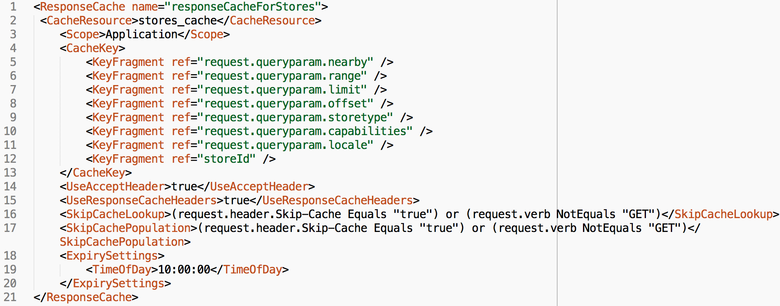
Response Cache (cont’d)

Slide 9
Populate Cache / Lookup Cache
Optimizes API performance by reducing request or response processing.
can cache any object. Typically used after building custom data
separate policies for cache population vs. lookup
specify a time-to-live
full control of population and lookup of cache via policies

Slide 10
Choosing which caching policy to use…
Use Response Cache:
when identical requests and their corresponding identical responses are common (cache hits will be frequent)
to reduce unnecessary traffic to backend
to reduce latency for common requests
Use Populate Cache / Lookup Cache:
when storing custom data objects (not always backend http response) to store data sets that have a specific maximum number of entries (vs. key value maps)
to persist data across multiple API transactions

Slide 11
Cache Utilization and Optimization
The use of caching is only beneficial if requests are being served from cache. There are key things to ensure your cache solution is obtaining optimal performance.
Ensure your cache key is built in such a way that the only request parameters used for the key are ones that dictate the client’s response. (e.g. don’t just use the URI as things like timestamps and other unique items can end up as part of the key resulting in 0% cache hits.
Take advantage of the cache scope. Multiple APIs might utilize the same cache so set the scope to be ‘organization’ and re-use.
Cache performance dashboard is available in Apigee Analytics to report on cache hit % and performance gains.

Slide 12
Clearing the cache
Using the UI
allows you to clear the entries for a complete cache resource
typically used to invalidate all cache entries
Management API
same as UI with the addition of being able to specify a prefix used for cache keys
typically used to invalidate all cache entries
Invalidate Cache Policy
allows you build a fully customized API resource to invalidate specific entries
used in implementations to invalidate specific cache entries

Slide 13
THANK YOU

